Slide 1
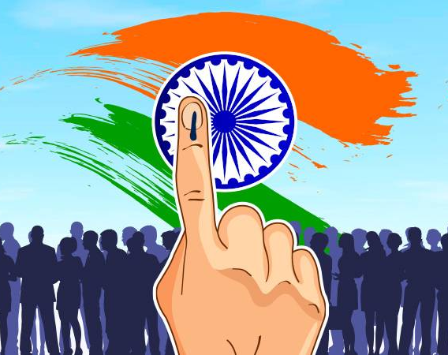
"Revolutionizing Democracy: The Power of Online Voting"
Anirudh Harsh RK21WYB48
Amit Gupta RK21WYA27
Vishal Singh RK21WYB45

Slide 2
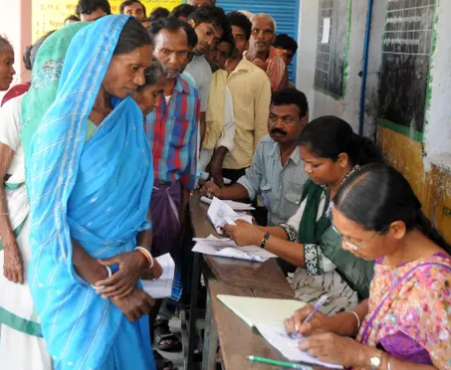
Introduction
Problem Definition:- The existing manual Voting system consumes more time for Vote Casting.
The election officer must check the voter , this voter can vote in the booth then check voter ID present in voter list.

Slide 3

About Project
The objective of the system is a replacement of the traditional system that is in existence.
This smart system reduces the time for voting and also the system is reliable, and faster.

Slide 4
SCOPE OF PROJECT
Voter can Vote from anywhere for his/her Constituency.
It Increase the Voting Percentage.
It Maintains all The Information of all the Candidates and Vote.

Slide 5
ADMINISTRATIVE MODULE:
Online Voting is a voting system by which any Voter can use his\her voting rights from anywhere in India. Online voting for association contains-:
· Voter’s information in database.
· Voter’s Names with ID.
· Voter’s vote in a database.

Slide 6
AWT Library
Java AWT components are platform-dependent i.e. components are displayed according to the view of operating system. AWT is heavy weight i.e. its components are using the resources of underlying operating system (OS).The java.awt package provides classes for AWT API such as TextField, Label, TextArea, RadioButton, CheckBox, Choice, List etc.

Slide 7
Swing Library
Java Swing tutorial is a part of Java Foundation Classes (JFC) that is used to create window-based applications. It is built on the top of AWT (Abstract Windowing Toolkit) API and entirely written in java.
Unlike AWT, Java Swing provides platform-independent and lightweight components.The javax.swing package provides classes for java swing API such as JButton, JTextField, JTextArea, JRadioButton, JCheckbox, JMenu, JColorChooser etc.

Slide 8
DESIGN
Data Flow Diagram:- The data flow diagram(DFD) is a graphical tool used for expressing system requirements in a graphical form. The DFD also known as the “bubble chart” as the purpose of clarification system requirements and identification major transformation that will become program in system design.

Slide 9
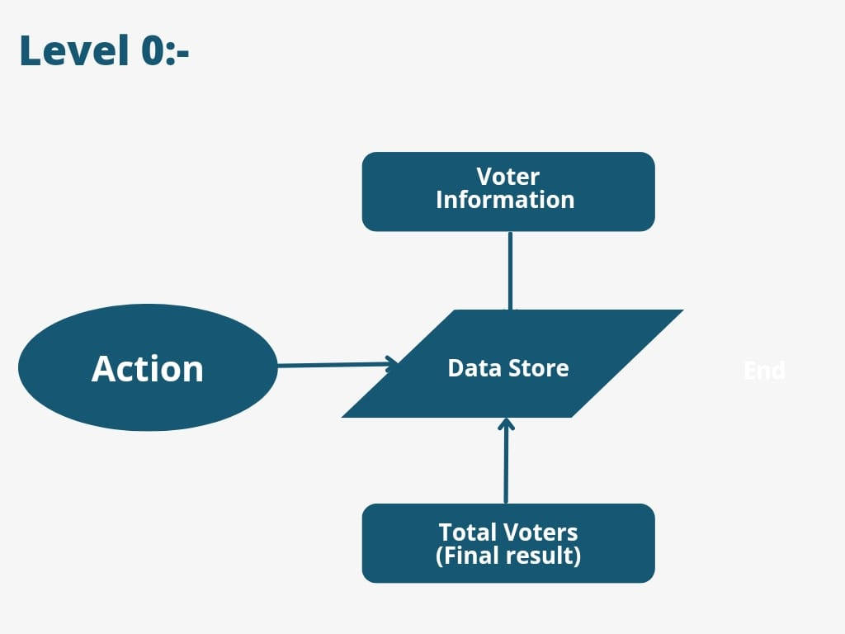
DFD(Data Flow Diagram)
L 0.

Slide 10

What problem online voting systems solve in this today's time?
Online voting systems can make the voting process more accessible and convenient for voters, especially those who may have difficulty physically accessing polling stations or have scheduling conflicts on election day.
Online voting systems can potentially increase voter turnout, as they can make it easier for people to participate in the democratic process from wherever they are located.

Slide 11

Why we need online voting system?
Online voting systems offer convenience and accessibility to voters who may not be able to physically go to a polling station, such as those who live in remote areas or have mobility issues.
Online voting systems can improve the speed and accuracy of vote counting, potentially reducing the likelihood of errors or fraud that can occur in manual counting processes.

Slide 12

Where we need online voting systems?
Online voting systems can increase voter turnout by making it easier and more convenient for people to vote, especially those who live far away or have mobility issues.
Online voting systems can also reduce the costs associated with traditional voting methods, such as printing ballots, renting polling stations, and hiring staff to manage the voting process.

Slide 13

Future prospects
Data of all votes can be stored in decentralized storage using blockchain technology. This can solve the problem of transparency in National/states election
Increased accessibility and convenience for voters, potentially leading to higher voter percentage and participation in democratic processes.

Slide 14
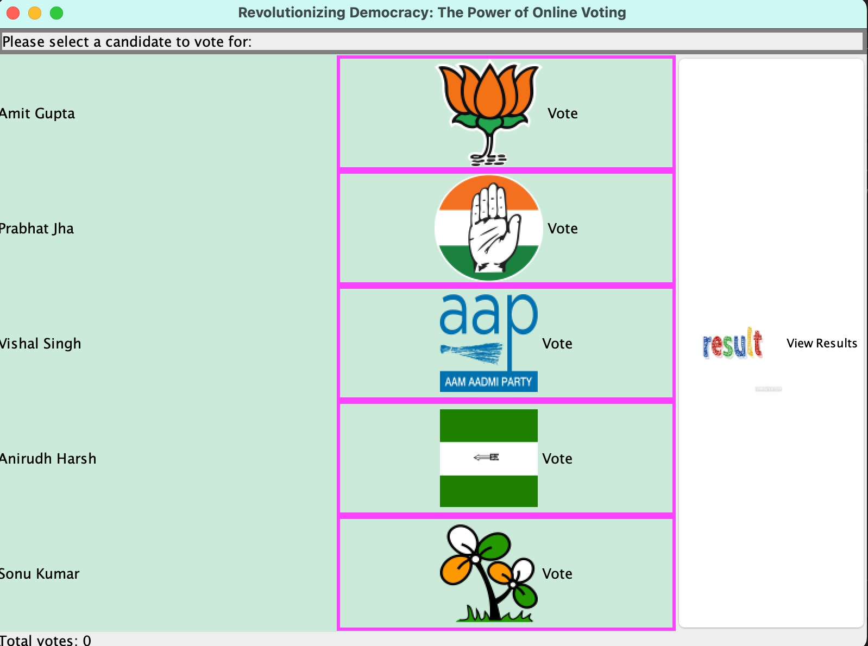
Screenshot of the Output

Slide 15
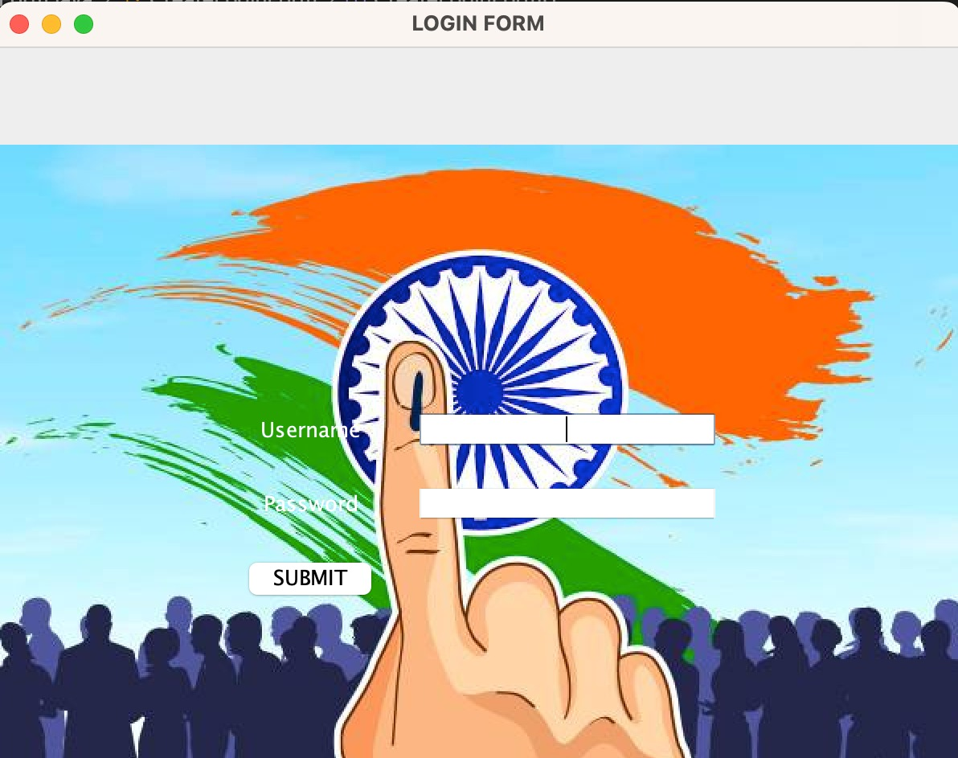
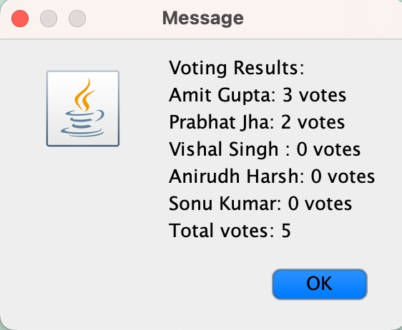
Screenshot of the Output

